Slide 1

SQL COMMANDS

Slide 2
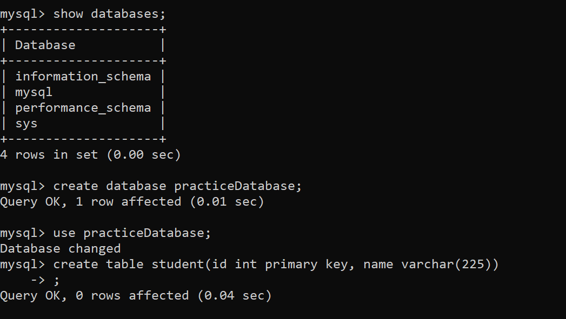

Slide 3
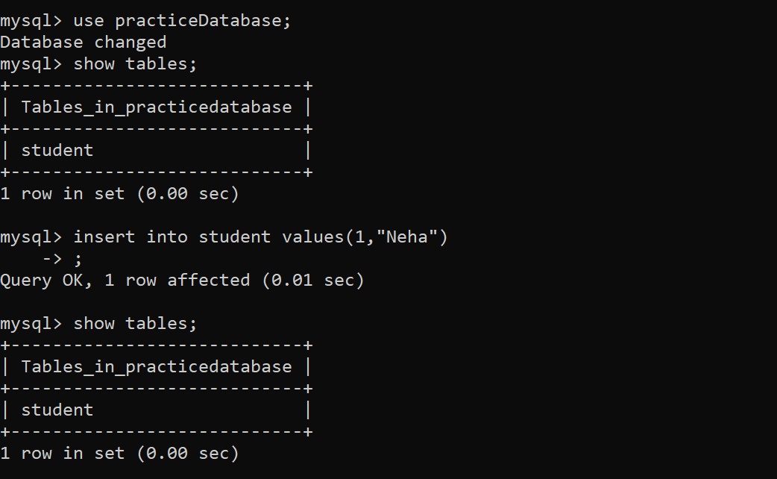

Slide 4
